Slide 1
Morphology Paradigms

Slide 2
Morphology Paradigms
In linguistic Morphology ,a paradigms is the set of forms (inflections) that can occur from a single element . For example ,the word “question” can be both noun and a verb.
Morphological paradigm(example: Walk-walks-walking-walked) are of central interest to both linguistics and natural language processing researcher for connectedness jumps, jumping sharing the text lexeme JUMP.

Slide 3
Morphology Paradigms
Realizational morphology or "word-and-paradigm" (WP) was a theory first created by linguist, Charles F. Hockett.
WP morphology focuses on the whole of a word rather than morphemes or internal structure. This theory also denies that morphemes are signs (form-content pairs).
The theory takes paradigms as a central notion. Instead of stating rules to combine morphemes into word-forms, or to generate word-forms from stems, word-based morphology states generalizations that hold between the forms of inflectional paradigms.

Slide 4
Morphology Paradigms
Morpheme-based theories analyze such cases by associating a single morpheme with two categories. Item-and-Process theories, on the other hand, often break down in cases like these, because they all too often assume that there will be two separate rules here, one for third person, and the other for plural, but the distinction between them turns out to be artificial.
Word-and-Paradigm approaches treat these as whole words that are related to each other by analogical rules.

Slide 5
Morphology Paradigms
Words can be categorized based on the pattern they fit into. This applies both to existing words and to new ones. Application of a pattern different from the one that has been used historically can give rise to a new word, such as older replacing elder (where older follows the normal pattern of adjectival comparatives) and cows replacing kine (where cows fits the regular pattern of plural formation

Slide 6
Morphology Paradigms
Under this two category are follows-
Stem identification
Paradigmatic similarity

Slide 7
Stem identification
The structure within a morphological paradigm, focusing on stem identiﬁcation.
The goal is to device general independent strategies for stem extraction applicable for different types of morphology across languages, and goes beyond the common substring-based approaches.
Stem identification which are sufficiently work with both concatenative and Non Concatenative morphology.
Linearity and Contiguity
Substrings, multiset and subsequence

Slide 8
Linearity and Contiguity
a substring with respect to linearity and contiguity, consider the string “abcde”. “a”,“bc”, and “cde” are its substrings. “ac” is not a possible substring, because “a” and “c” are not contiguous. “ba” is not a substring either, because “a” does not linearly come after “b” in the string “abcde”.

Slide 9
Substrings, multiset and subsequence
 | Substrings | Multiset | Subsequence
Linearity | True | False | True
Contiguity | True | False | False

Slide 10
Pragmatic Similarities
Pragmatic Similarities asks what structure there is across morphological paradigms. Word forms across paradigms do not alternate in the same pattern.
At the same time, however, morphological patterns are also systematically similar.
Linguists discuss this in terms of inﬂection classes, which introduce differences across morphological paradigms

Slide 11
Pragmatic Similarities
This focuses on the modeling of paradigm similarity and develops a string-based hierarchical clustering algorithm that computationally characterizes the similarity and differences across morphological paradigms.

Slide 12
Inflection classes
Morphological paradigms often do not inﬂect in the same way, which leads to inﬂection classes.
For example, Spanish verbs are classiﬁed into three conjugation groups (commonly referred to as -AR, -ER, and -IR verbs), illustrated in Table 3 for the inﬂectional sufﬁxes(all person and number combinations) in present indicative.

Slide 13
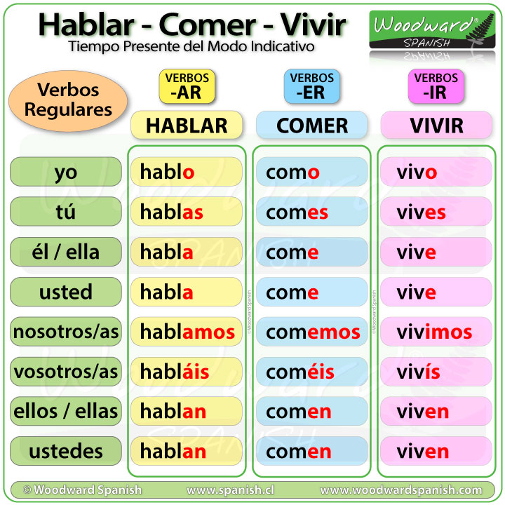
Inflection classes

Slide 14
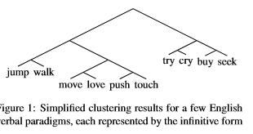
Clustering for paradigm similarities
Paradigm similarity in a way that is amenable to a linguistic analysis and a formal model of paradigm similarity useful for computational tasks related to paradigms.

Slide 15
Thank you

